Slide 1






Presentation by
Flédéric Payet

Slide 2

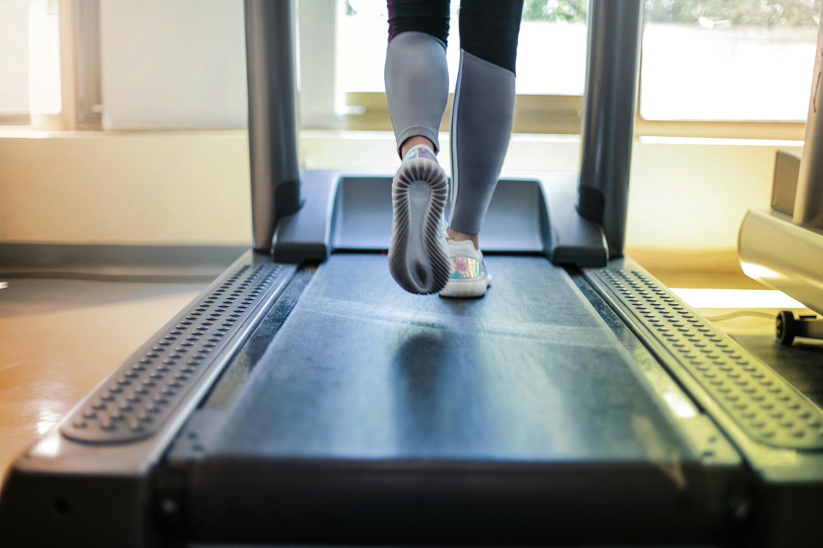

“An innovative methodology with proven results, designed to stimulate the endocrine system and to reactivate and recalibrate the metabolism for increased energy, vitality, endurance, and faster recovery (Hormonal balance and neurotransmitter release)”*
*Metabolic Synchronization

Slide 3
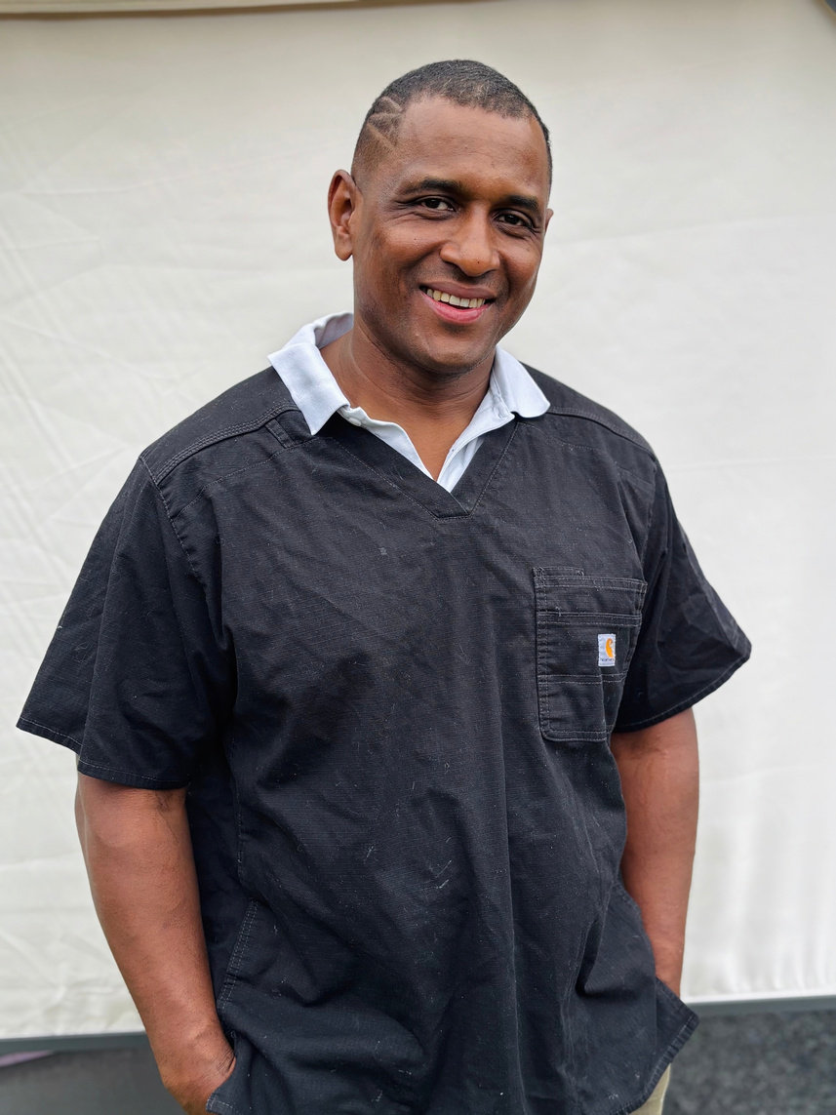
Over the past two decades, I have met countless people in distress in various parts of the world or continents. I come from an intense French island myself, the Réunion, full of diversity.
I have been confronted with patients suffering from many diverse health issues, as well as with challenges faced by athletes or elite units. Since then, I have continuously developed new methods to adapt to each individual following much research and experimentation.
The gym has become a kind of preventive and curative hospital for me as I now understand the principles of metabolic synchronization and the natural stimulation of the endocrine system.
The results across all types of profiles have been extremely convincing, whether for athletes, people suffering from various pathologies, or amateurs.
Founder
Biography

Slide 4
Logo
Introduction
01
“Imagine your body is a bicycle, and for it to function properly, it requires regular maintenance. You need to oil the chain, tighten the brakes, change the tires, tighten the bolts, and ensure the suspension is in good condition.
Why this analogy? Because it reflects the metabolic functioning of the body.
02
The chain represents blood flow. The chainring represents cardiac resistance. The small and large gears represent heart rate or cardiac pulsation.
This means that I will modulate the effort so that the body reaches a certain ease, which I call metabolic effort, because it provides an instant renewal of energy rather than exhaustion.”

Slide 5
It is a unique protocol designed to naturally stimulate the endocrine system, and trigger the release of neurotransmitters using very specific and adaptive heart frequencies through targeted efforts. As a result, energy levels, endurance, and vitality increase significantly, allowing for complete and faster recovery from fatigue— whether caused by health issues or intense athletic training.
This method can be followed universally and successfully by people at any age or in any physical condition.
What is
Metabolic
Synchronization ?
Its direct and positive impact on the health of patients represents a major breakthrough in physical training because it applies to anyone:
  People with Minor to Major Health Issues
  Professional and Amateur Athletes
  The military or special forces

Slide 6
People with Minor to Major Health Issues
This program has been successfully followed by individuals suffering from severe chronic fatigue, fibromyalgia, migraines, heart problems, hypertension, burnout, depression, etc. (See testimonials at the end of this presentation.)
Professional and Amateur Athletes
Athletes can increase their performance and accelerate their recovery time before, during, and after training or competitions—without using supplements (legal or otherwise). This unique program complements their usual training routines and enables faster and more complete recovery, improving overall performance and reducing the risk of injury. Metabolic synchronization has helped professional athletes in motorsports, tennis, football/soccer, etc. (See testimonials.)
The Military & Special Forces
Methodology designed to naturally stimulate the endocrine system and recalibrate metabolic functions. This process triggers the release of key neurotransmitters—dopamine, endorphins, serotonin—resulting in heightened energy levels, increased endurance, improved cognitive clarity, and significantly accelerated recovery. Originally developed through field experience with civilians, athletes, and individuals suffering from severe fatigue, the methodology has proven exceptionally effective for military personnel, special forces operators, tactical units, and individuals exposed to extreme physical and psychological demands such as firefigthers.

Slide 7
What Metabolic Synchronization Does NOT Do
The method is designed to naturally stimulate the endocrine system, resulting in positive effects on health and performance. It complements—not replaces—traditional medical systems.
Objectives of the Method
  Reactivation of the metabolism
  Improvement of endurance and strength
  Enhancement of overall health
  Personalized and progressive sessions

Slide 8
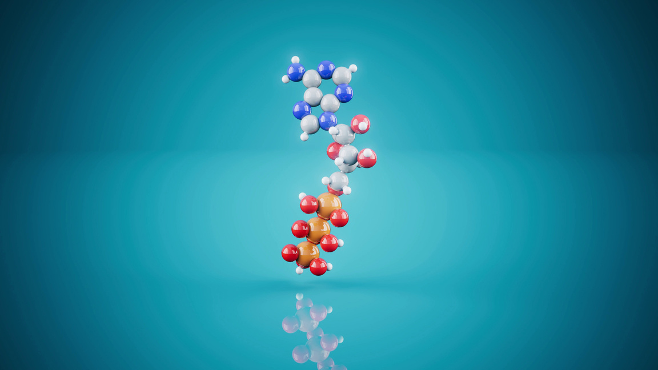
Method: “Metabolic Effort”
01
My method combines protocols in which I guide cardiovascular frequencies and pulsations during effort in order to optimize nervous and cognitive functions, and to maintain or recover the body’s integrity with the objective of ensuring its defense, promoting the repair of lesions, and stimulating energy expenditure with a clear improvement in body composition.
02
Sessions are adjusted according to each person’s level, goals, and constraints. Progressive management of intensity with active recovery.

Slide 9
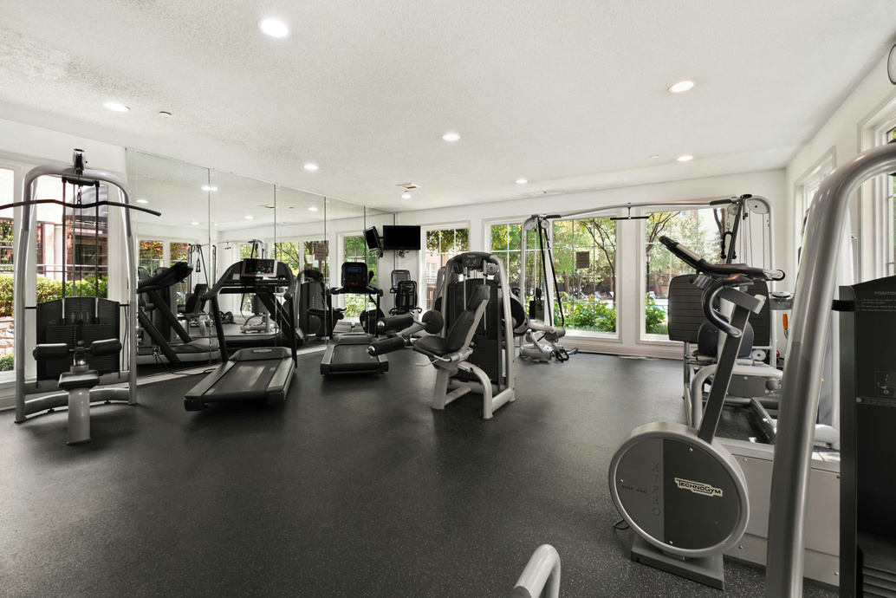

Stationary bikes; treadmills; ellipticals; stair climbers; strength machines; guided strength equipment, etc.
  I integrate all these tools to vary stimulation and maximize the effectiveness of metabolic effort.
Who Can Access and Benefit from This Method?
  All profiles from 14 to 99 years old, with or without disabilities.
Note: For confidentiality reasons, the protocols remain within the domain of intellectual property.
Equipment
used

Slide 10
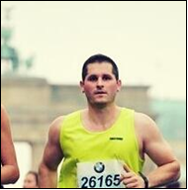
Testimonials
“My name is Christopher Kirschgens. I am 35 years old and an avid athlete. In my youth I played a lot of handball and football. Including in handball in a team of the Rhineland. Professionally, I had to give up the two team sports and look for another hobby. I started running, swimming and cycling and added weight training. Among other things in the following years, I took part in several obstacle courses (Tough Mudder or Strongman Run). For me, my first marathon in Zurich with my wife Alexandra was probably the most beautiful sporty success of my athlete's existence. I then ran two more marathons, Berlin 2017 and Freiburg i. B. 2018. Currently, my sport is limited to fitness training.
At the end of 2018 Flédéric spoke to me in the gym, he suggested to train me physically and physically healthier and to provide me with his training and his concept. “Christopher”, he said, “if you work out with me, I'll take you up to the top.” Flédéric talked to me about weight training and health and told me that he had seen me in the gym for a long time and followed my training. He gave me a detailed idea of ​​his concept and made me understand why it is so important to train so that I still have profit of it in old age. It is not important that you put a lot of weight on the equipment and train, it is more important that you perform exercises for everyday life which help to prevent injuries or senile deficiency. Flédéric also gave me a nutrition plan for the upcoming weeks. Important in his concept is that you should separate from the bad energy the bad feeling in your body. It should be transported away from the inside of the body to the outside away from yourself. The training should also prevent illness or, after a serious illness, lead back to positive energy and health.
In the upcoming days Flédéric developed a training concept especially for me and my needs. It should be noted that I work professionally at the German Customs and carry about 8 kg of personal equipment with me on the body (personal balistic vest, firearm and use various operating resources). Of course, this weight has a negative effect on my bones and joints; e.g. the knee joint, spine, hip bone joints, intervertebral discs.
Flédéric started the warm-up program with me and explained to me exactly why we warm up just like that. The warm-up program lasts approx. 20 up to max. 30min. Then it was time for different exercises ...
We did this four times a week; once a week he did a very special training with me where I had to give full throttle. Each workout, however, was max 1 hour. Then he sent me to take a shower and I felt really fresh and powerful. I never felt bad and leached out neither had pain or tension. I was really curious about what he was teaching me in the next training session.
Flédéric tunes the training specifically for its participants. It brings you very fast forward and you notice the muscle growth. I did exercises that I haven’t known before. Besides that, new exercises were added over and over again. Flédéric is right there for you and motivates you during the training. It was really great fun which is very important as well. On the one hand the training pushed you out of the comfort zone to bring you further. On the other hand the training with Flédéric made you feel being in good hands. I was surprised how well I felt after each workout - exhausted, but happy and full of power; I’ve never had any pain. Since the workouts with Flédéric I’ve never had problems with the intervertebral discs and joints as described above any longer.
To sum it up: I can 100% recommend Flédéric’s concept and training.”
Christopher Kirschgens
- Athlete -

Slide 11
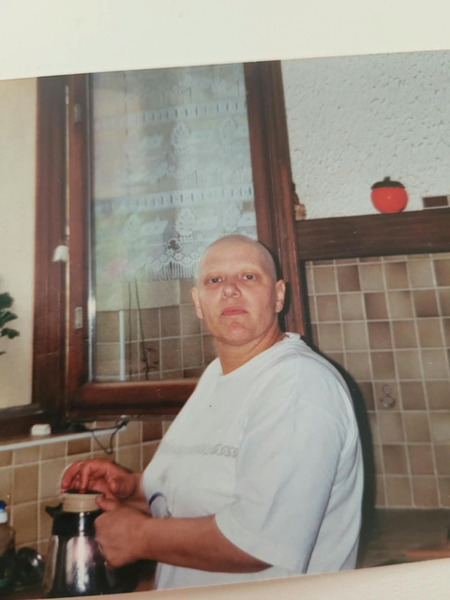
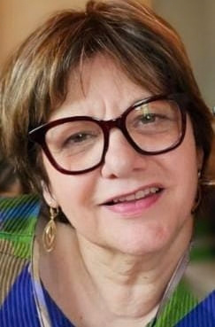
Geneviève Jelsch, 57, breast cancer, fibromyalgia and Lyme disease
“Let me introduce myself. I am Geneviève. I was born in Alsace, in France, in 1962. In 2009, I started feeling pain in my joints and as the years went by, the pain became unbearable. I would scream at night because of severe pain occurring for no reason and I would scare my husband in the meantime. It was extremely violent. Words can’t express the pain I underwent. I didn’t understand what was happening. The doctors had no concrete answer either. All they said was it was probably a result of my former breast cancer. I had to decrease my working hours and eventually stopped working as I could hardly walk.
A few years later, my GP finally diagnosed a fibromyalgia and on top of that, the Lyme disease! I was then hospitalized because of a facial palsy which caused me to stutter for more than a year.
At that moment, I met Flédéric Payet through a friend of mine who was already part of his program. I started training with him and changing my diet. I rapidly started feeling better and feeling myself coming back to life. I was full of energy again and I felt like I could climb mountains. My husband couldn’t believe his eyes!! He was very surprised to witness the significant positive changes after many years of agony. None of my siblings and friends recognized me either. I was not the same person anymore. It changed my life. I even started working again!!
I followed Flédéric’s program for 2 years, including 5 training days a week in his care. As of today, I still exercise and I live a normal life. I cannot thank Flédéric enough for all that he has done for me, including comforting and supporting me during times of discouragement. He never hesitated to come and visit me at my place in times of need. I will be forever grateful to him.”
Before / After pictures

Slide 12
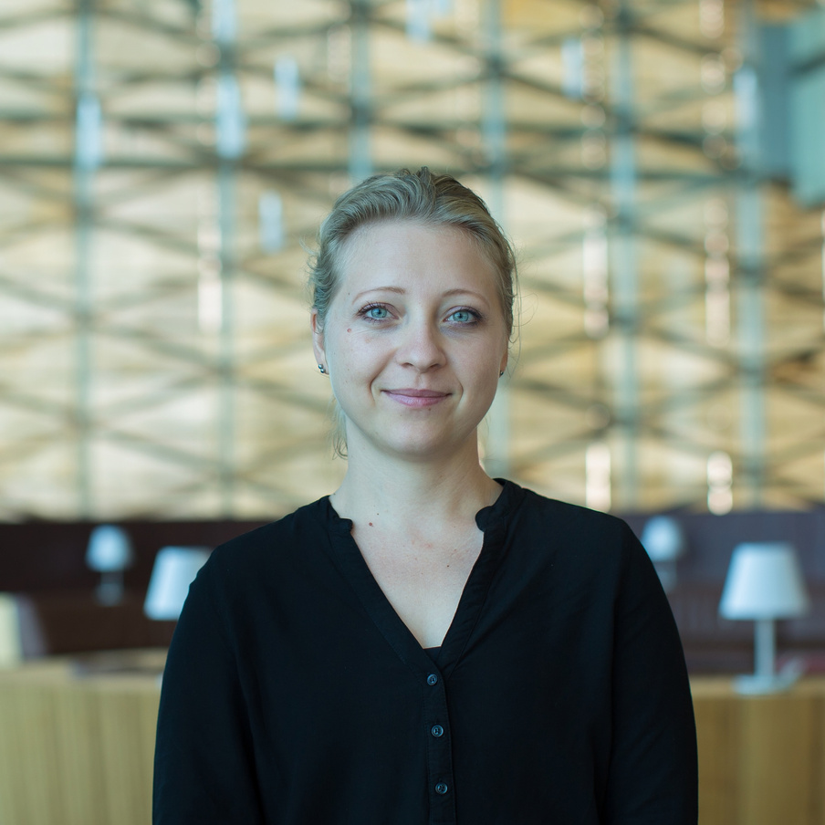
Julia Eichmann, mid-thirties, depressed and aiming at physical performance
“When I met Flé for the first time, I saw a group of people running around the gym and he was yelling “allez allez” it didn’t look like your average gym session but everyone looked so happy afterwards! I decided to talk to him and will forever be grateful that I did!
With Flé I did not only learn about sport and workouts and health but also how to push my boundaries and some important lessons for life. During one of the most difficult times of my life, his training was the only thing that kept me going and made me get up in the morning.
I don’t know where I would be today, if not for him. I cannot express how grateful I am that we met. With him I achieved amazing results in short time and learned how to keep up the level by myself after I moved away and didn’t have him as a coach anymore.
It was also astonishing to watch the transformation of other people in the gym. Witnessing how people who could barely walk started to run and push weights.
I can only recommend everyone to meet Flé as a coach and as a person - it will change your life forever!” 6/6

Slide 13
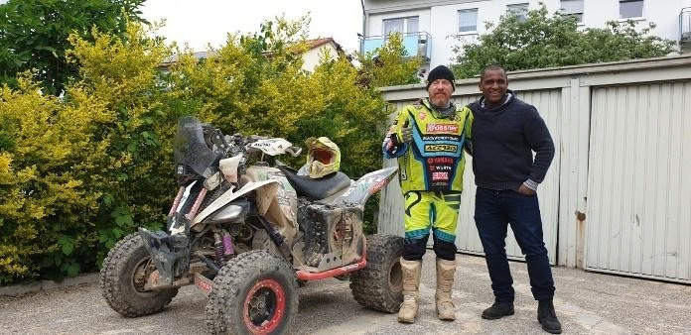
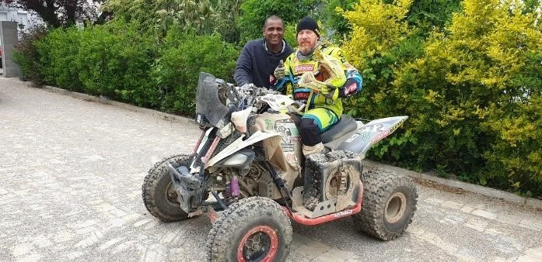
Juan Carlos Carignani, Dakar Rally Competitor
“Hello, my name is Juan Carlos Carignani, I am a Rally Dakar competitor and I would like to give some feedback about the training I have been doing with Fléderic.
The Rally Dakar is the hardest, biggest and longest Rally of the world, in which the participants face many dangerous situations and are exposed to two weeks of extreme efforts requiring endurance. In addition, there are many complications which require you must be mentally and physically prepared if you want to get through the whole Rally race.
Thanks to Flédéric’s training, in which he prepared me with effective exercises, I achieved a very good overall fitness. It was a very productive training in preparation for physical strength and endurance.
The results during the race was beyond expectations in the sense that I could remain strong and capable of facing harsh conditions.
I am very satisfied with this preparation program and recommend it for any kind of sport.”

Slide 14
Thank You for Attention

